Slide 2
Unit-1 : Sensor fundamentals and characteristics
Introduction to sensors, Types of sensors
Performance characteristics, and applications
Location sensors, Optical sensors
Electrochemical sensors, Mechanical sensors
Dielectric soil moisture sensors, Airflow sensors
pH sensors, Accelerometer sensors
Nano sensors, Nano biosensors, Application of sensors
Practice: Application of sensors in agriculture - Soil moisture sensors for monitoring plants, Electronic soil sensors to conserve water.

Slide 3
Presentation Outline
What – Sensor
Why - Sensor
What - Characteristics
How – Characteristics
One type

Slide 4


Slide 5
Sensors
Device
Provides a usable output
Response to a specific measurand
Output – electrical / mechanical / optical quantity
Measurand – Physical quantity

Slide 6
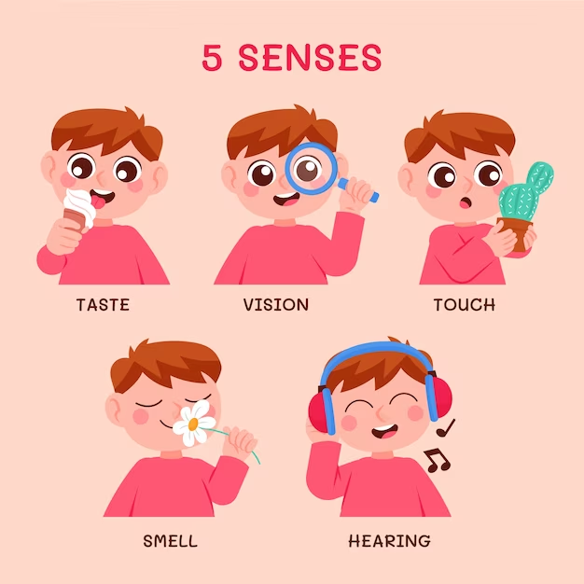
Five senses

Slide 7

Real time applications

Slide 8
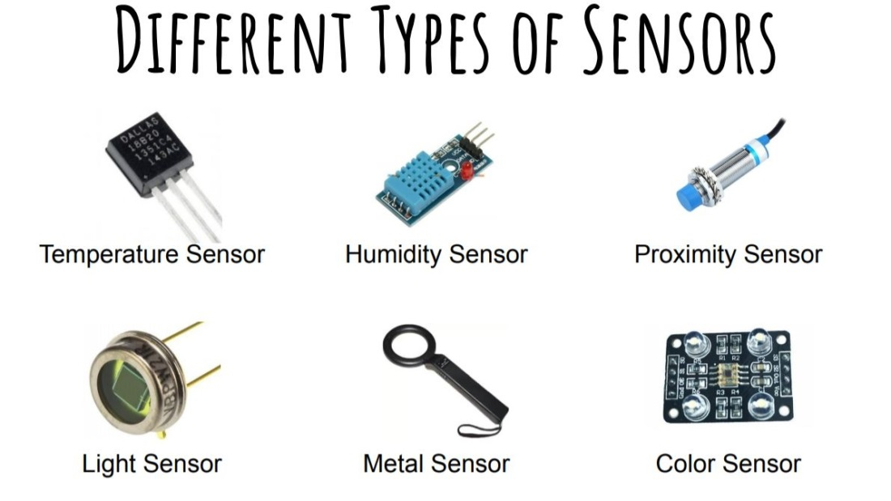
Different types of sensors

Slide 9
Why Sensors?
Smart devices need to measure different physical parameters
Different applications require sensing of physical parameters to address a real life problem
Automation requires information of different physical parameters

Slide 10
Principles [Sensor Vs Transducer]
Sensor
Senses a variation in input energy
Produces an electrical output
Transducer
Uses transduction principle
Converts a specific measurand into usable output
Example: Piezoelectric Crystal, Strain Gauge
When with electrodes and input and output mechanisms becomes a transducer

Slide 11
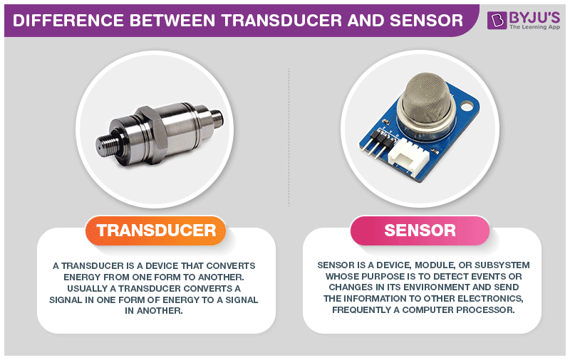

Slide 13
Energy types and measurands
Energy | Measurands
Mechanical
Length, area, volume, force, pressure, acceleration, torque, mass flow, acoustic intensity
Temperature, Heat flow, Entropy, State of matter
Thermal
Electrical
Charge, Current, Voltage, resistance, inductance, capacitance, polarization, frequency, electric field, dipole moment
Magnetic
Field intensity, Flux density, Permeability, Magnetic Moment
Radiant
Intensity, Phase, Refractive Index, Absorbance, Wavelength
Chemical
Concentration, composition, oxidation, reaction rate, pH

Slide 14
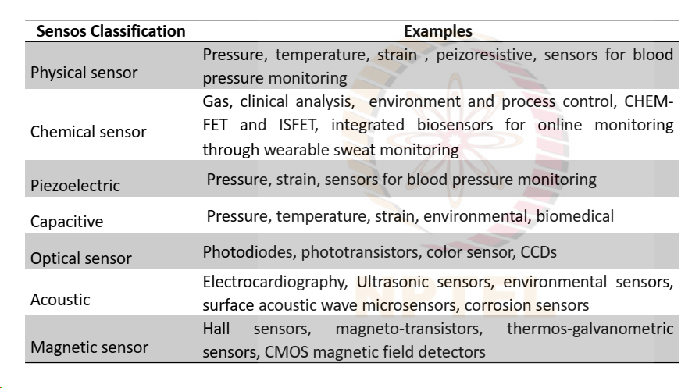

Slide 15
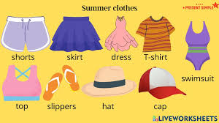
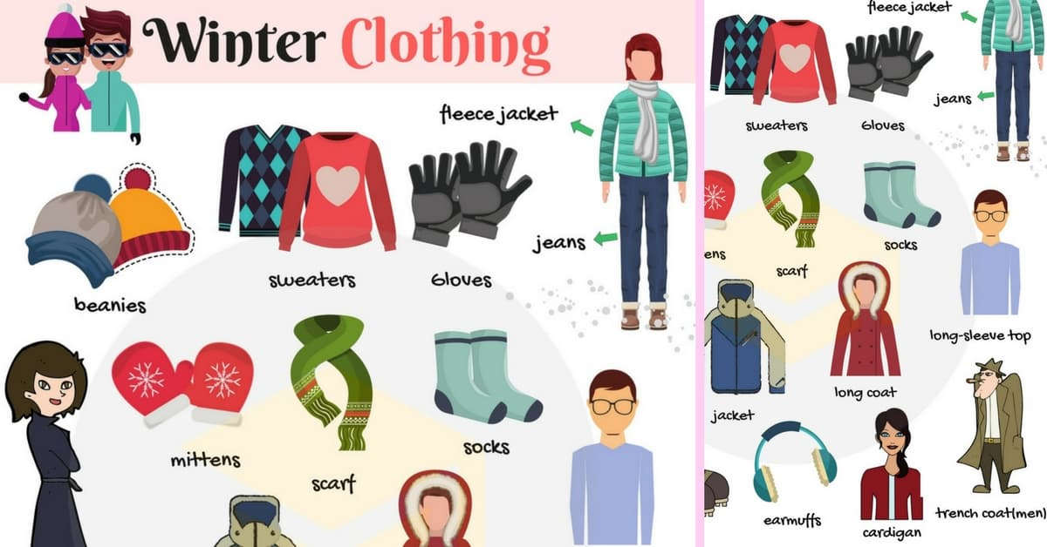
Clothes

Slide 16
Sensors
Application 1
Application 2

Slide 17
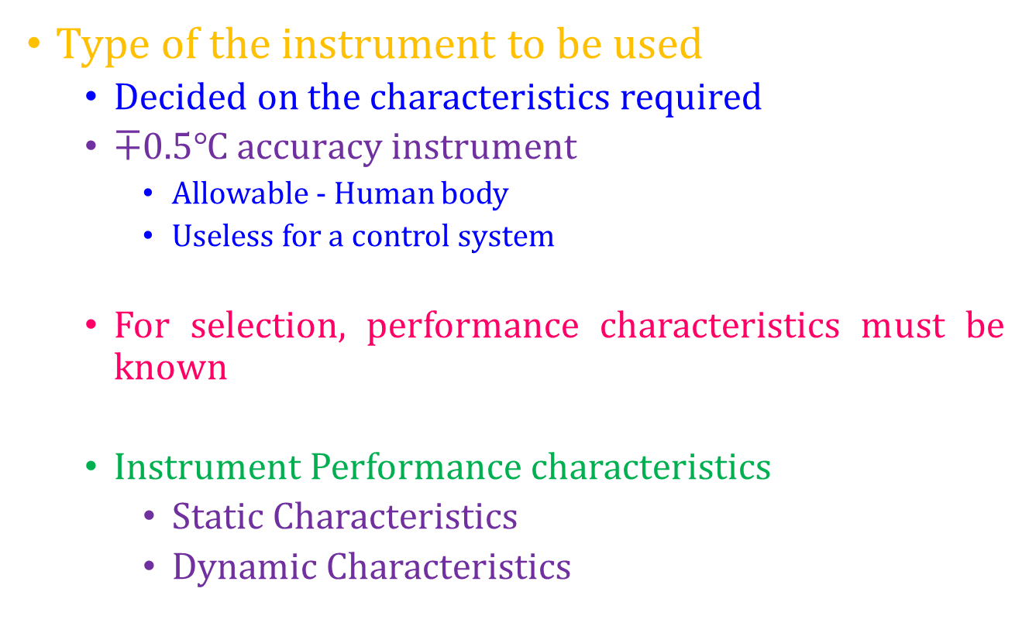
Why?

Slide 18
Characteristics
Characteristics
Static
Dynamic

Slide 19
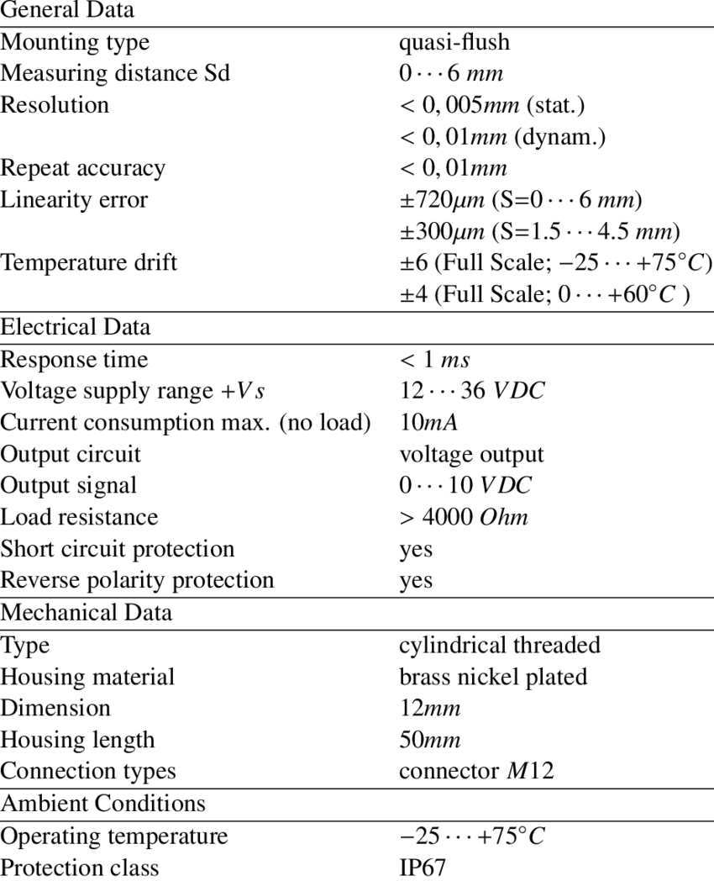

Slide 20
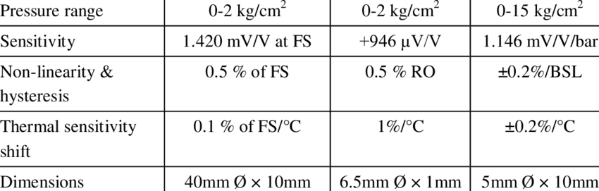

Slide 21
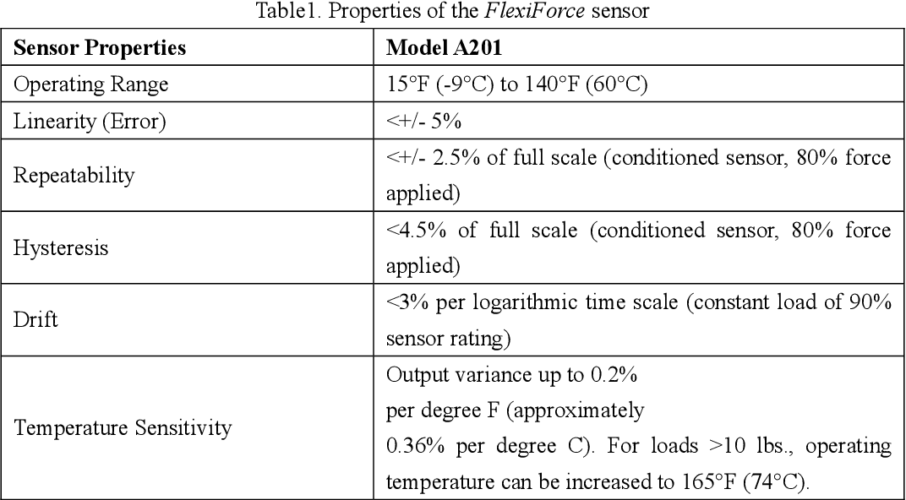

Slide 22
Static Characteristics
Describe the performance of instruments where the measured quantities
Constant
Slowly varying
Concerned with steady state reading
When the instrument settles down

Slide 23
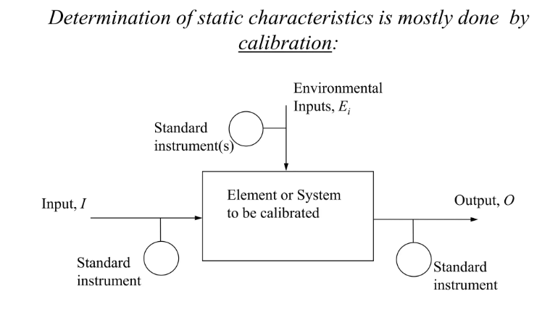
Determination of Static Characteristics

Slide 24
Static Characteristics
Range
Accuracy
Precision
Resolution
Sensitivity

Slide 25
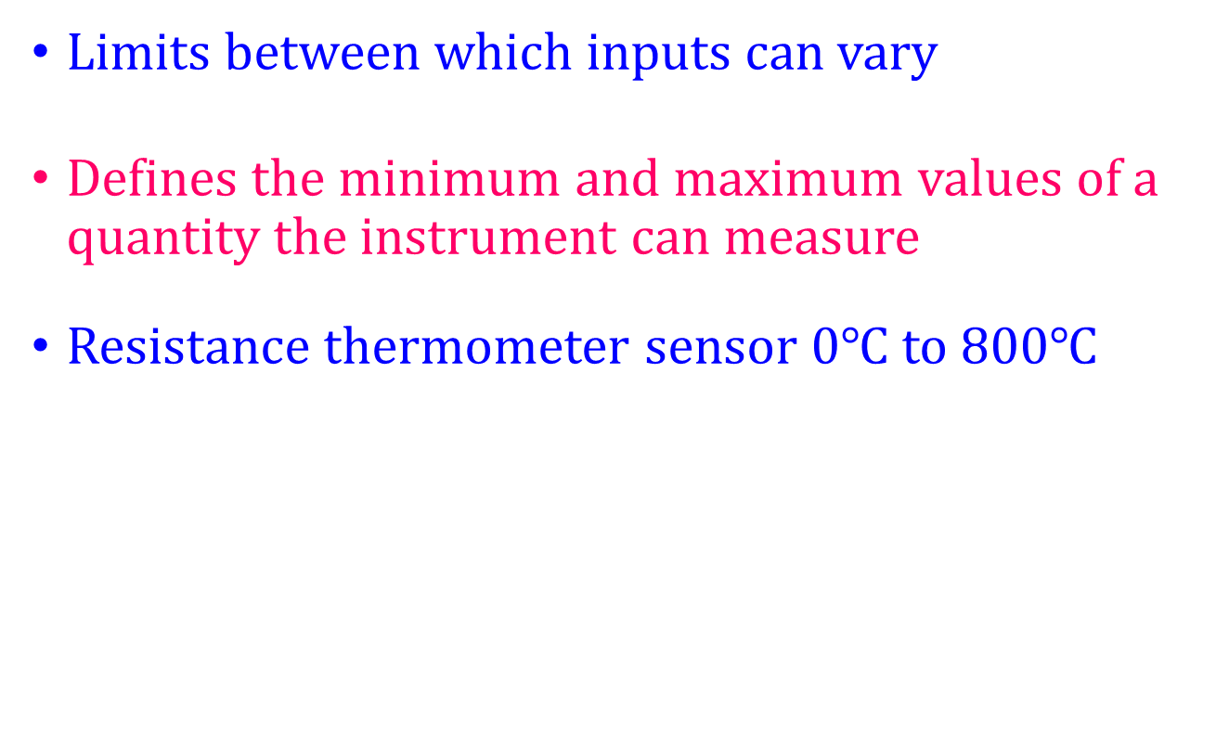
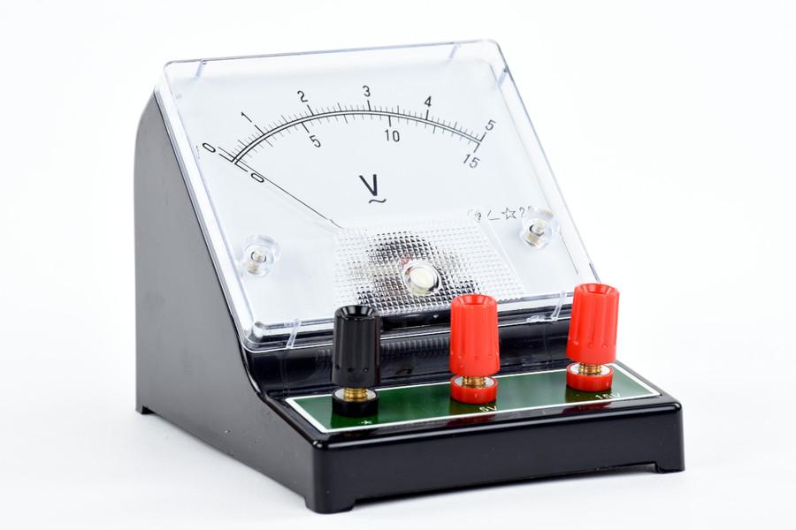
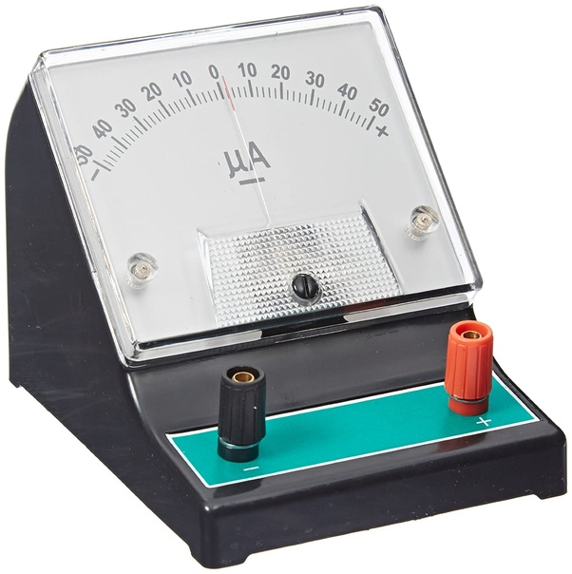
Range

Slide 26
Accuracy
How closely the measured value matches the true value.
Maximum expected difference in magnitude between the measured and the true value
Often expressed as % of full scale reading

Slide 27
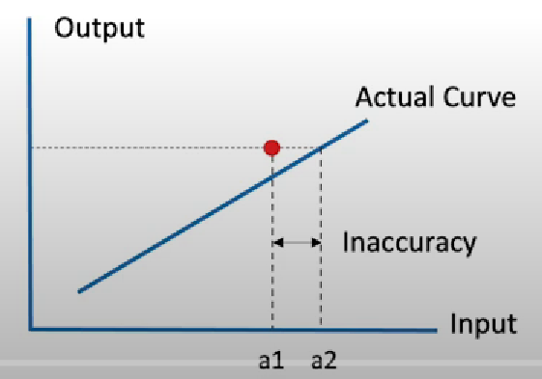

Slide 28
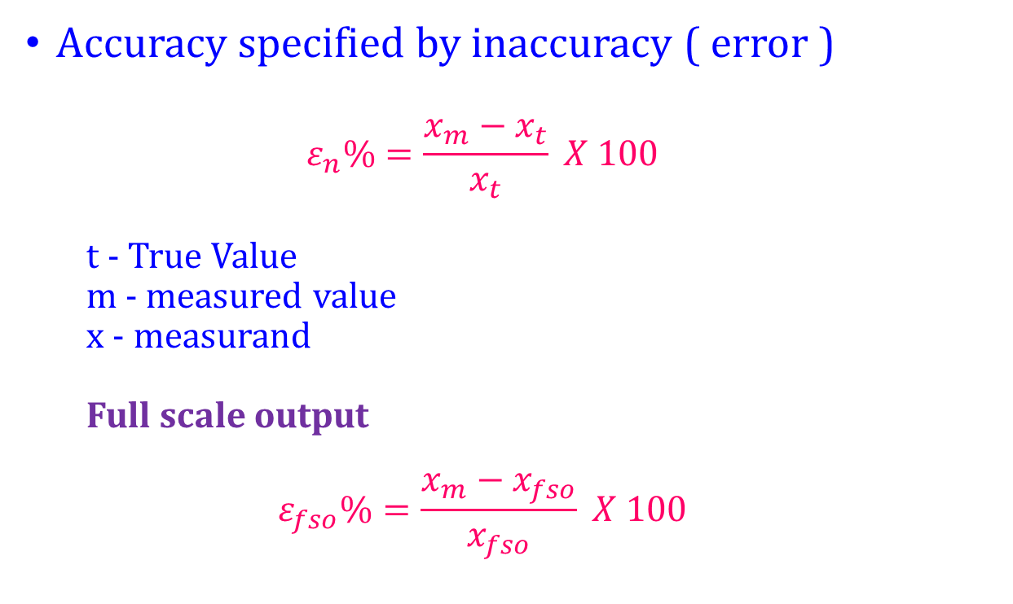
Static Characteristics

Slide 29
For example, if the instrument
Full scale = 100 m
Reports a pressure of 88.0500 m
The actual pressure is 88.0000 m
The difference is 0.0500 m (5 cm)
Accuracy (or error) is 0.05%.

Slide 30
If a pressure sensor with a full scale range of 100 psi reports a pressure of 76 psi – and the actual pressure is 75 psi, then the error is 1 psi, find the accuracy (or error) of the sensor
Accuracy = 1%

Slide 31
Precision
How close a measured value is to the true value and how far it is reproducible.

Slide 32
Repeatability
Capability of a sensor to
provide the same output repeatedly
when used each time to measure the same input

Slide 33
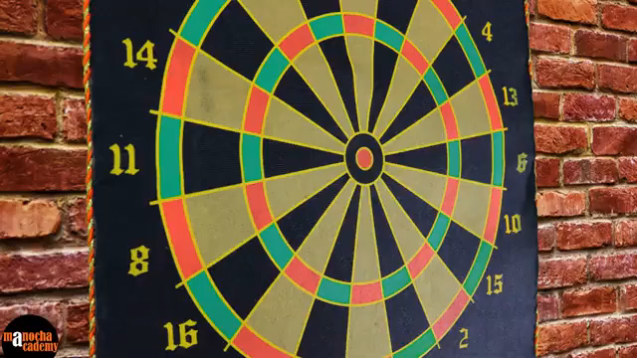

Slide 34
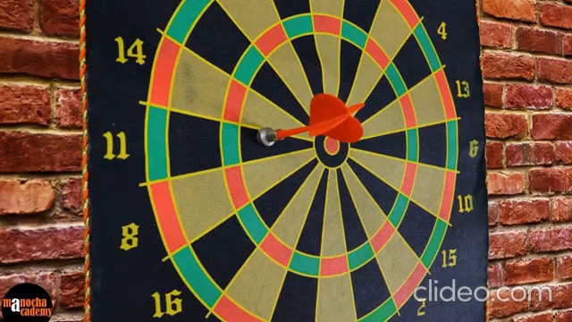

Slide 35
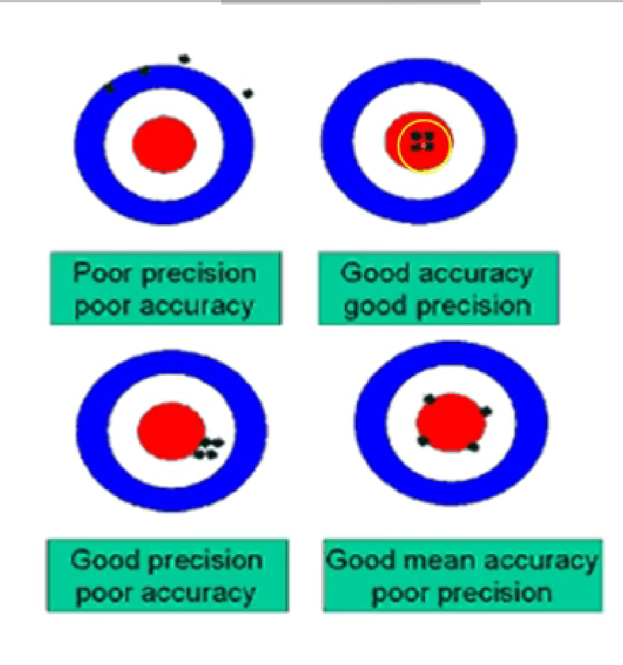

Slide 37
Resolution
Smallest change in the input that is needed to produce a observable change in output.
Minimum input change that can be detected by the instrument
Higher resolution means smaller increments

Slide 38
Instrument with a 5 digit display 0.0000 to 9.9999
Instrument with a three digit display 0.00 to 9.99

Slide 40
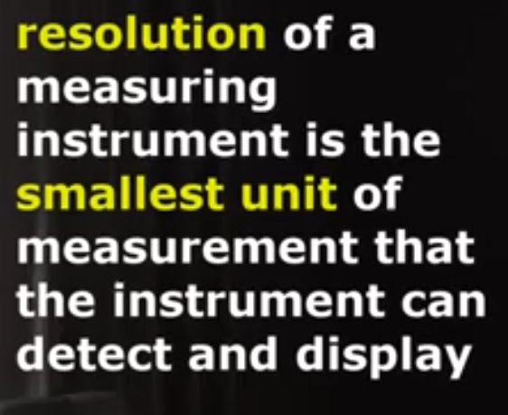

Slide 41
For example, the Levelogger 5 M100 has a resolution of 0.0006% FS. This means with a full scale of 100 m, the sensor will be able to detect a 0.0006 m (0.6 mm) change in pressure. Resolution usually varies over the range of the instruments, e.g. the Levelogger 5 M5 has a resolution of 0.001% FS

Slide 42
Example: a digital voltmeter with resolution of 0.1V is used to measure the output of a sensor. The change in input (temperature, pressure, etc.) that will provide a change of 0.1V on the voltmeter is the resolution of the sensor/voltmeter system.

Slide 43
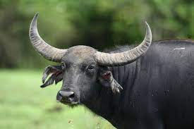
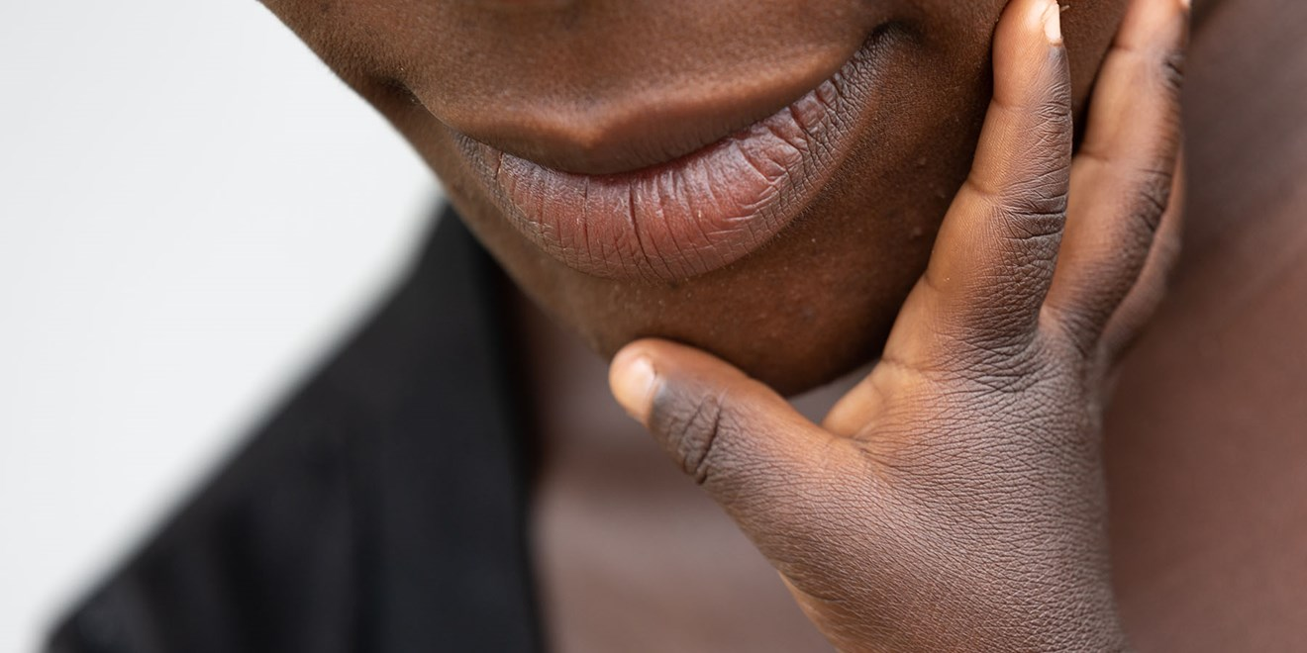
Sensitivity

Slide 44
Sensitivity
Change in output to the corresponding change in input
Slope of the input output curve
Ratio of incremental output to incremental input
Indicates by how much the output changes when the quantity being measured changes by a given amount
Refers to the least change in measured value to which instrument or device responds

Slide 45
If the mercury in a thermometer moves 1 cm when the temperature changes by 1 °C, its sensitivity is 1 cm/°C
Temperature measurement with a Platinum Resistance Thermometer
Temp changes from 0 °C to 50 °C the resistance changes from 100 ohm to 119.4 ohm.
The sensitivity is 119.4 – 100 / 50 - 0 =19.4 / 50 = 0.388 ohm / °C

Slide 46
RESOLUTION - the smallest portion of the signal that can be observed
SENSITIVITY - the smallest change in the signal that can be detected

Slide 47
Drift
Sensitivity of a sensor varies with ambient conditions like time, temperature, humidity..etc
without any change in input level

Slide 48
Selectivity
Ability of a sensor to discriminate the response to input changes from other interfering quantities.

Slide 49
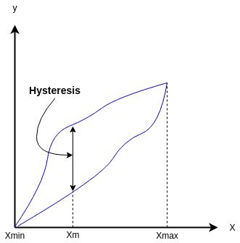
Hysteresis
The difference in the output of the sensor for a given input x when x reaches this value in upscale direction and downscale direction.

Slide 50
Hysteresis
Will not have the same output for the same input in repeated trials
Mechanical Friction or thermal effects

Slide 51
Dynamic Characteristics
How well a sensor responds to changes in its input.
How it responds fast enough to keep up with the input signals.
Thermometer and Fan

Slide 52
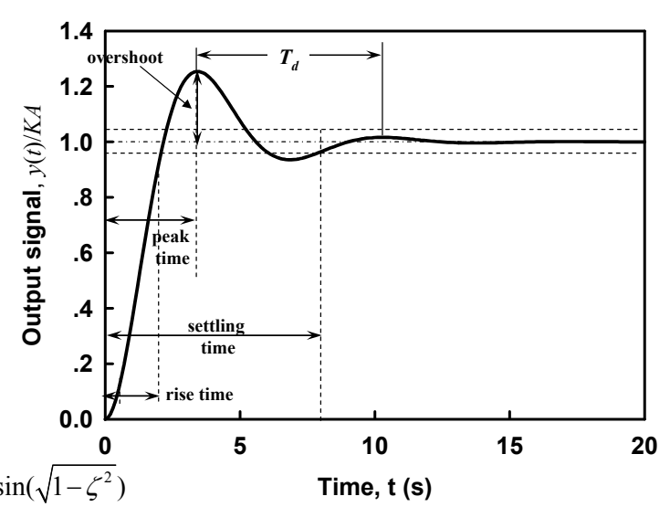
Dynamic Characteristics

Slide 53
Dynamic Characteristics
Speed of Response
Rise time
Settling Time
Time constant
Transfer Function
Frequency Response

Slide 54
Types of Sensors?

Slide 55
Objective
Understand the different types of sensors used in agriculture

Slide 56
Presentation Outline
Why sensors in agriculture?
What are they used for?
What are the different such types?

Slide 57
Why sensors?
Challenges in agriculture
Benefits

Slide 58
Challenges
Rapid growth in society
Decreased rainfall
Labor shortages
Demand for excess food
Climate unpredictability
Poor soil from lacking land management

Slide 59
Solution ?
Current situation wants farming to become more “smart”
Provide data that helps farmers monitor and optimize their crops
Keep updated with changing environmental and ecosystem factors.
Treat sick cows while locating and tracking their herd

Slide 60
Benefits of Using Agriculture Sensors
Helps maximize returns with minimum resources
Are simple and easy to install and use
Can be remotely controlled
Provides information about pollution and climate change
Empowers farmers to plan for the future
Can be controlled by mobile apps precisely

Slide 61
What are they used for?
Used to empower farmers
Measures or detects natural world conditions such as motion, heat, or light and converts this condition into an analogue or digital representation
Provide them with real time data about their fields and crops
Can help them make better decisions
Discover that the nutrients in the soil of a particular field are depleted - to switch farming techniques and to care for that field
Internet of Things technology

Slide 62
Location sensors
Used to help manage weather conditions
Positioned at different places in a field to gather data about weather
Use GPS location data to determine where certain phenomena are occurring

Slide 63
Location sensors
Utilized to improve irrigation schedules and reduce water usage

Slide 64
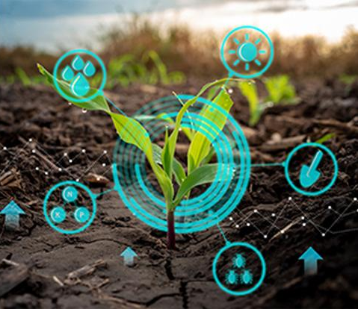
Optical Sensors
Based on light’s absorption or reflection
Depends on the surface of the object
With intensity of reflected light can determine
Presence and absence of the object
Notes:
When light hits an object some are absorbed and some are reflected

Slide 65
Optical Sensors
Measure the amount of light reflected from plant leaves
More light that is reflected, the healthier the plant is
Green plants absorb much of the visible light wavelengths
The blue and red light waves
Reflect much of the green light waves
Can provide a relative measure of chlorophyll in the leaves

Slide 66
Optical Sensors
Include
Infrared
Soil moisture content
Ultraviolet
Detects pests and diseases in crops
Detect fungal spores
Hyperspectral sensors
Detect weeds and assess crop health

Slide 67
Optical Sensors
Employs light to measure soil properties
Can be installed and mounted on automobiles, satellites, drones, or robots
Cause the soil to reflect, which provides farmers with information about the soil and plant color
Can help measure the moisture of soil, the organic matter content of soil, the content of clay

Slide 68
Employs light to measure soil properties
Can determine clay, organic matter, and soil moisture content.

Slide 69
Air flow sensors
Measures Soil air permeability
For assessing the aeration conditions in the root zone of plants
Root respiration, microbial activity, and nutrient cycling
Different crops have varying requirements for soil aeration, and managing soil conditions is important for optimizing plant growth and overall soil health
Ability of soil to transmit air or gases through its pore spaces
Influenced by soil texture, structure, moisture content, and organic matter

Slide 70
Air flow sensors
Texture
Coarse-textured soils - sandy soils - have larger pores - higher permeability
Structure
Aggregates form naturally in the soil – weathering - organic matter decomposition - the activity of soil organisms
Way soil particles are aggregated
Well-aggregated soils with good structure - more interconnected pores – less compact layers
Moisture Content
Saturated soils
Well drained soils
Organic Matter
can improve soil structure - increase the size of pores

Slide 71
Air flow sensors - Functions
Ventilation
Maintain optimal conditions for plant growth
Proper air circulation - preventing the buildup of heat and humidity in greenhouses
High temperatures and humidity can create a favorable environment for diseases and pests
Pollination
Proper air movement can aid in the distribution of pollen
Preventing Mold and Fungal Diseases
Stagnant air - development of mold and fungal diseases
Adequate air flow - helps evaporation - reduces excess moisture, - prevents the growth of pathogens
Temperature Regulation
Excessive heat can negatively impact plant growth (in greenhouses or enclosed spaces)

Slide 72
Inference
Air flow sensors – not directly associated with plants - monitoring and controlling air flow - supports optimal plant growth - reduces the risk of diseases.

Slide 73
Air flow sensors – applications
Ventilation Control in Greenhouses
Aeration in Stored Grain Facilities
Monitoring Air Quality in Livestock Facilities
prevents the buildup of harmful gases like ammonia
Windbreak Management
for assessing the need for windbreaks
Pest and Disease Management
Frost Protection
help monitor air movement - combined with temperature data

Slide 74
pH Sensors
Used to measure the acidity or alkalinity of soil, water, or other agricultural inputs
Influences various biological, chemical, and physical processes in the soil-plant system.

Slide 75
pH Sensors
Soil pH Monitoring
Crop Suitability
Nutrient Availability
Water pH Measurement
Irrigation Water Quality
Fertilizer Management
Optimizing Nutrient Uptake
Environmental Monitoring
Monitoring Soil Health

Slide 76
pH Sensors
Precision Agriculture
Spatial Variability
Crop Disease Management
Disease Susceptibility
Remediation Planning
Lime Application
Real-time Monitoring
Continuous Monitoring

Slide 77
Accelerometer Sensors
Rate of change of velocity with respect to time
Commonly used to monitor the movement, vibrations, and orientation of objects or surfaces
Mainly related to monitoring and optimizing farming operations

Slide 78
Accelerometer Sensors
Equipment Health Monitoring
Automated Farming Systems
Crop Monitoring
Livestock Monitoring
Harvesting Optimization

Slide 79
Accelerometer sensors in agriculture
Growth and Development
Environmental Stress
Disease Detection
Nutrient Deficiency
Harvesting Optimization
Crop Quality Assessment

Slide 80
Accelerometers can be integrated into various devices or directly attached to equipment, such as tractors, ploughs, harvesters, or even to crops or livestock, depending on the application. The data collected from these sensors can then be analysed to make informed decisions about farming practices, equipment health, and overall farm management.

Slide 81
Dielectric soil moisture sensors
Calculates the moisture levels in the soil with the assistance of a dielectric constant.
Primarily used to determine the moisture levels of the soil for optimal crop growth.

Slide 82
Precision Irrigation
Water Conservation
Crop Health
Energy Savings
Data-Driven Decision Making
Improved Crop Yields
Environmental Impact

Slide 83
Mechanical sensors
Used to measure soil compression or mechanical resistance
Provide valuable information about the physical condition of the soil
Soil mechanical resistance is recorded in a unit of pressure and points out the ratio of the force necessary to go into the soil

Slide 84
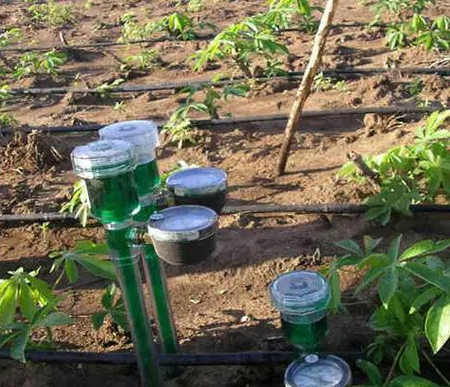
Mechanical sensors
To identify the force used by the roots of the plant for absorbing water
Can help in regulating irrigation interventions

Slide 85
Mechanical sensors – Functions
Soil Health Assessment
Compaction level – Limit root growth, Water infiltration, Nutrient uptake
Root Growth Monitoring
Resistance the root encounters
Crop Yield Optimization
Precision Agriculture

Slide 86
Equipment Calibration
Conservation Tillage Planning
Prevention of Soil Erosion
Resource Efficiency

Slide 87
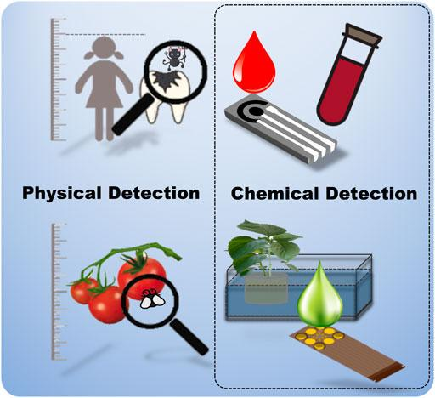
Electrochemical sensors
Monitor
Nutrient compositions of plant sap
Hydroponic nutrient solutions

Slide 88
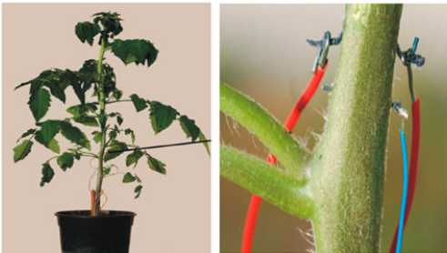
Electrochemical sensors
Implanted in a tomato plant stem for monitoring variations in the solute content of the plant sap

Slide 89
Electrochemical sensors
Inorganic nutrients (fertilizers) are essential for plant growth
Demand for these ions differs between plant types and growth stages
Phytohormones play a crucial role in regulating physiological processes
Auxins play a central role in the regulation of plant growth and development

Slide 90
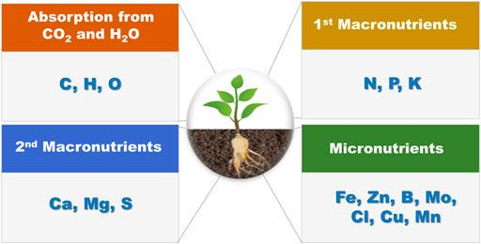
Electrochemical sensors

Slide 91
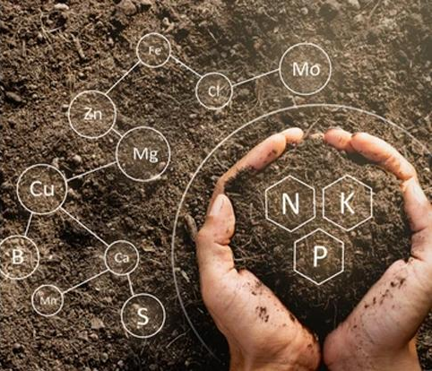
Electrochemical sensors
Gather chemical data of the soils by detecting specific ions in the soil
Provide information about the pH and soil nutrient levels
Electrodes sense the activity of particular ions, such nitrate, potassium, or hydrogen

